Slide 1

DogeVision
Harbour Space 2021

Slide 2
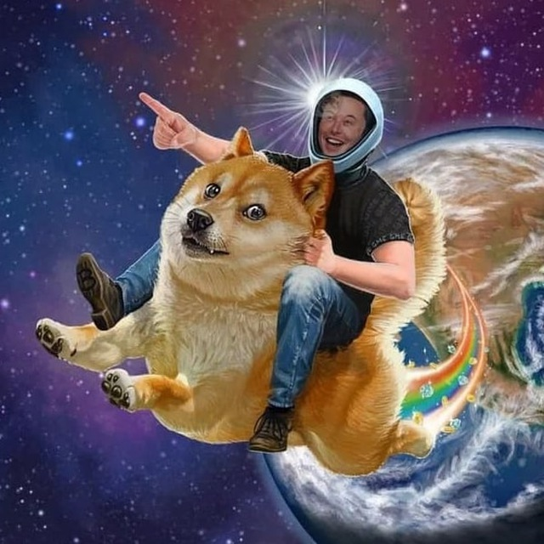

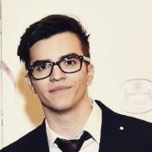
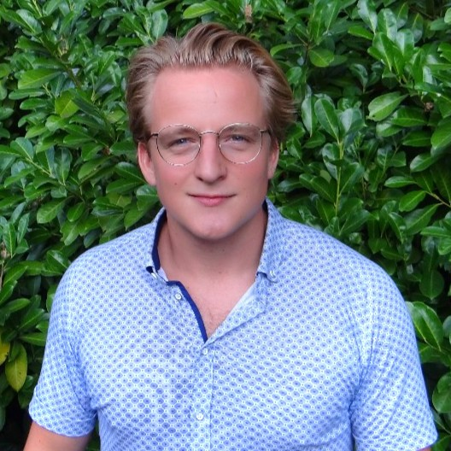
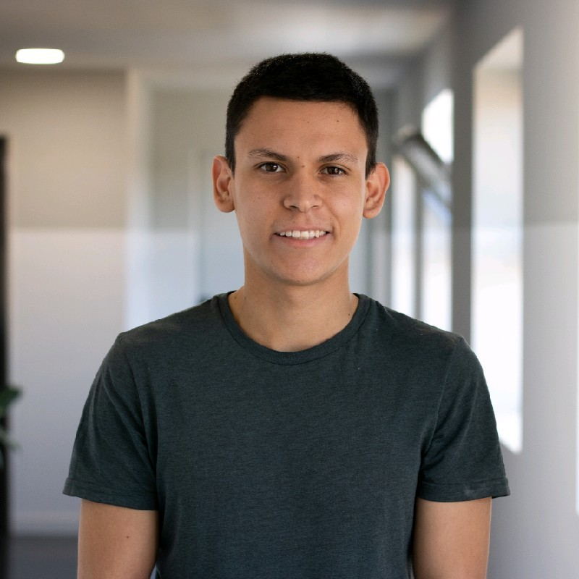
Duc Pham
Alex Simon
Berend Gort
Alejandro Martinez

Slide 3
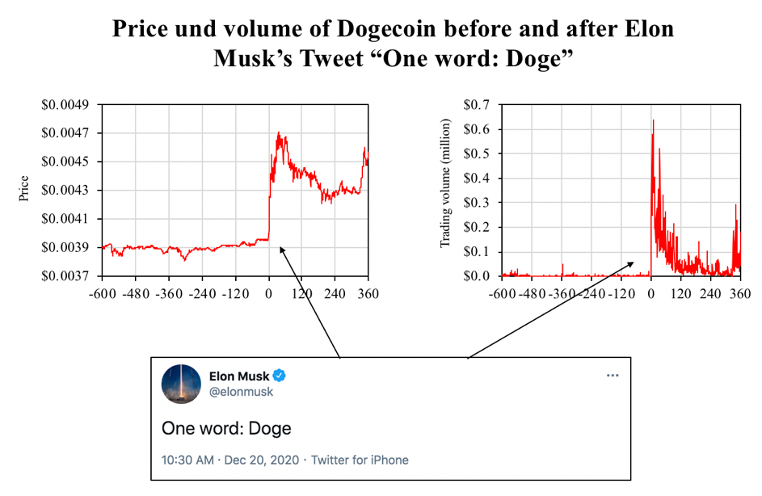
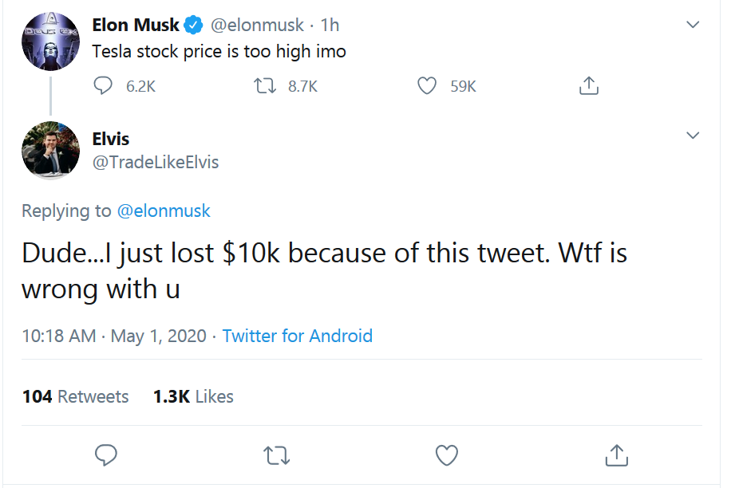
WHY?
Elon’s tweet effect on crypto/stock prices

Slide 4
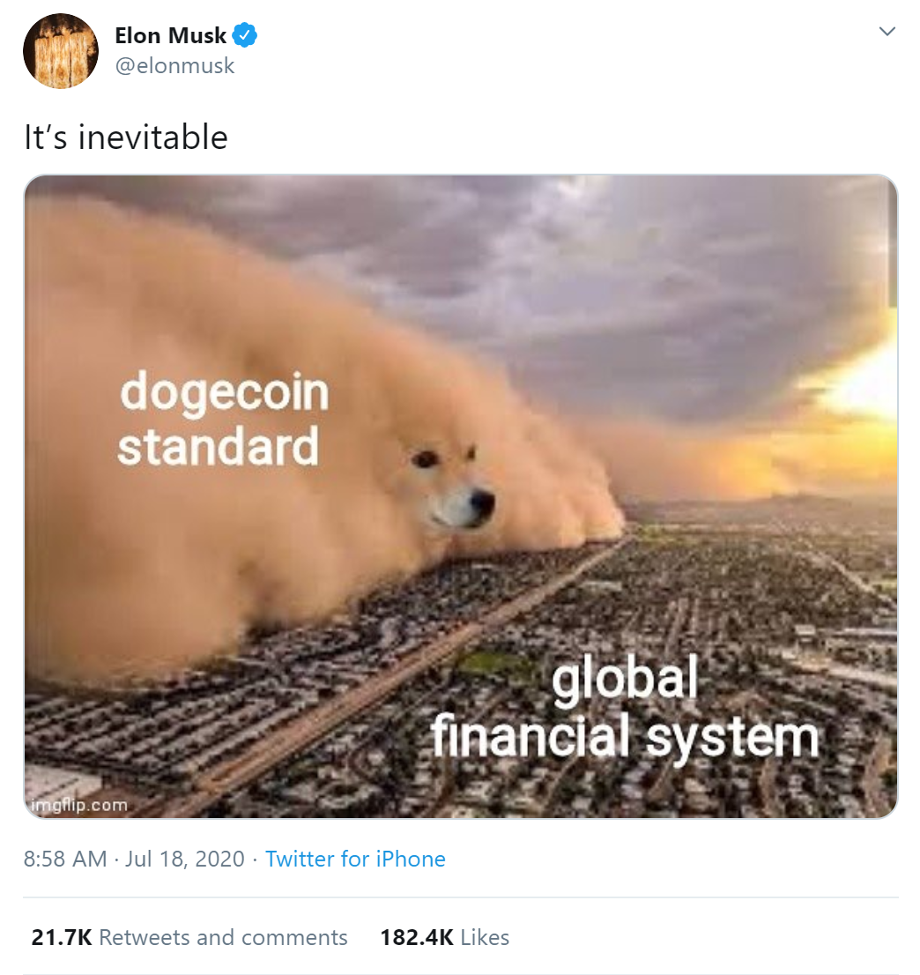
Our plan
Get alert whenever Elon post about doge
Immediately buy Dogecoin
Get ready for next bull run

Slide 5
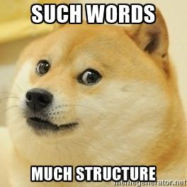
Outline:
📊 Dataset acquiring
🔮 Approaches
🕹️ Demo
✅ Conclusions

Slide 6
📊 Dataset acquiring
Dataset 1: from web scraping + augmentation
Positive (doge memes)
Negative (elon tweets / tesla / rockets / memes)
Dataset 2: all image from Elon’s tweets
Positive: 9 images
Negative: ~730 images

Slide 7
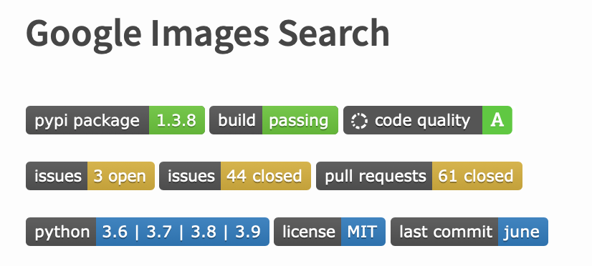
📊 Dataset acquiring
Dataset 1:

Slide 8
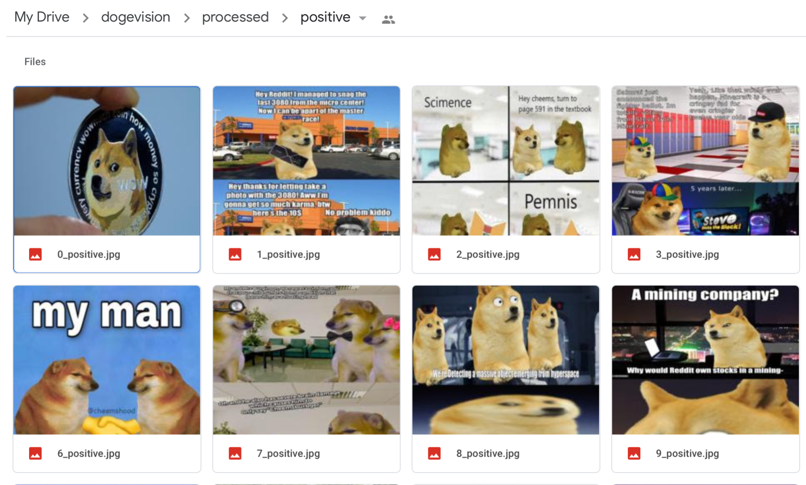
📊 Dataset acquiring
Positive (doge memes): ~ 200 images

Slide 9
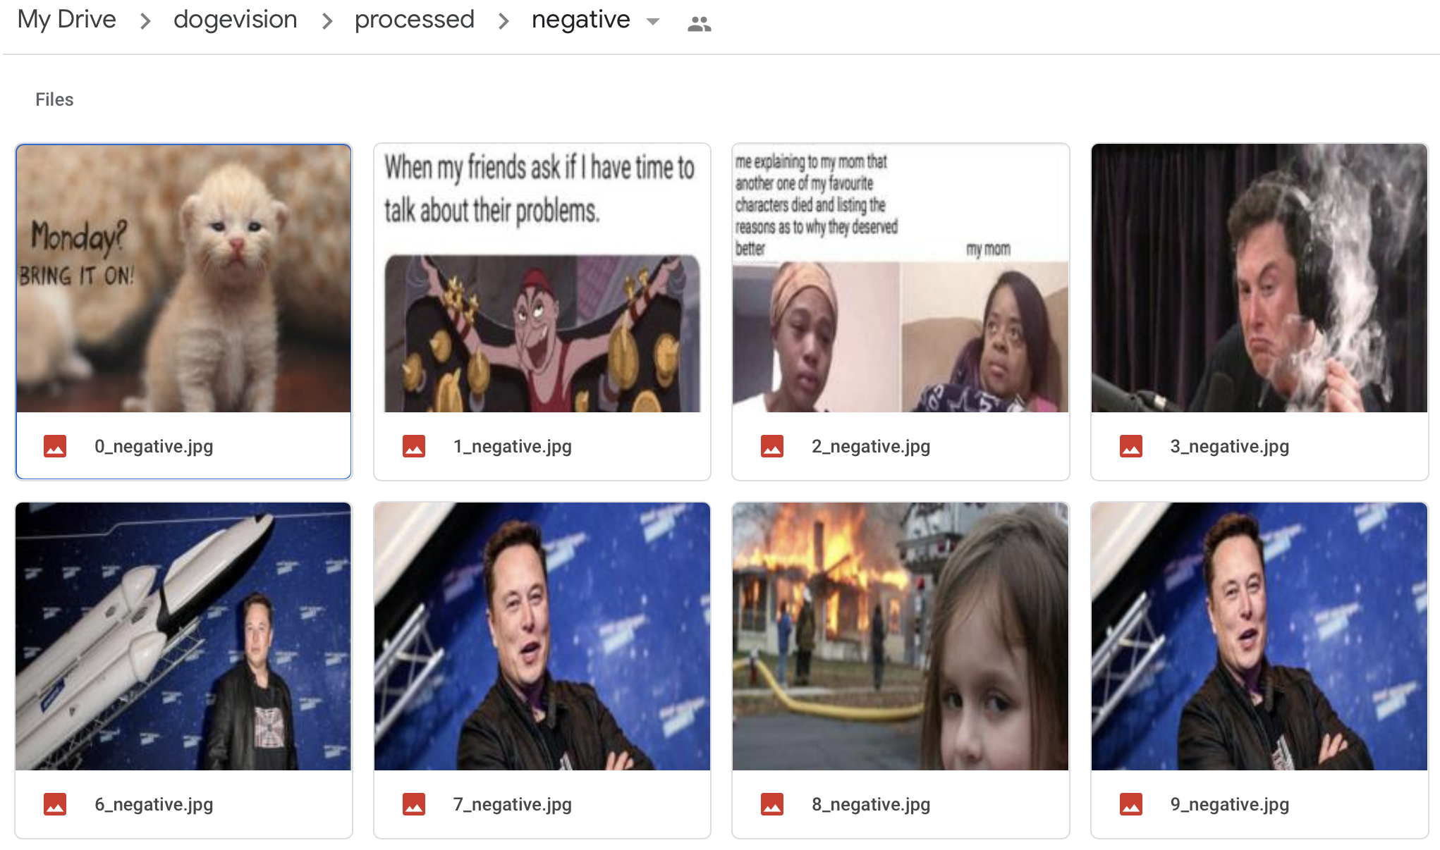
📊 Dataset acquiring
Negative (elon tweets / tesla / rockets / memes): ~ 450 images

Slide 10
🔮 Approaches
Pretrained models on Torchvision
AlexNet
ResNet
SqueezeNet
VGG
DenseNet
BiT-M model
1-Class Classification

Slide 11
🔮 Pretrained models on Torchvision
Initialize the pretrained models.
Reshape the final layer(s) to have the same number of outputs as the number of classes in our dataset.
Define for the optimization algorithm which parameters we want to update during training
Re train last layers.
Notes:
criterion = nn.CrossEntropyLoss()

Slide 12
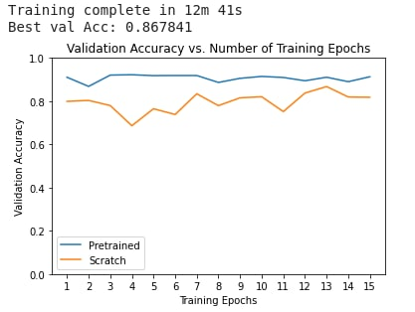
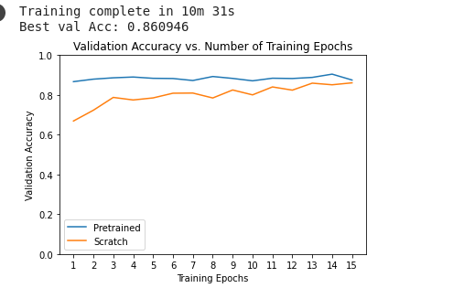
Fine tuning TorchVision models
Notes:
1.- resnet, 2 alexNet

Slide 13
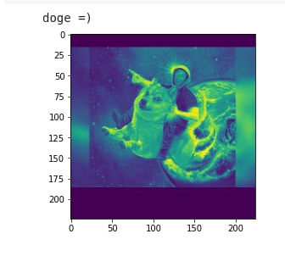
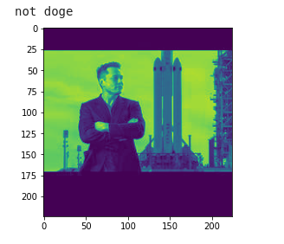
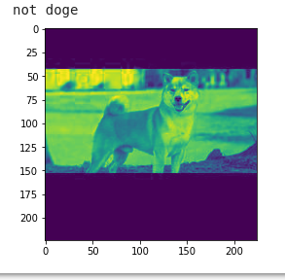

Slide 14
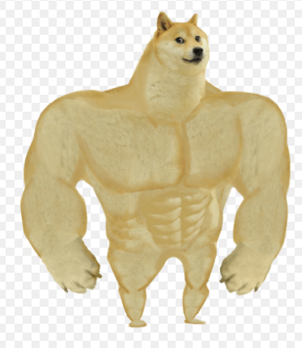
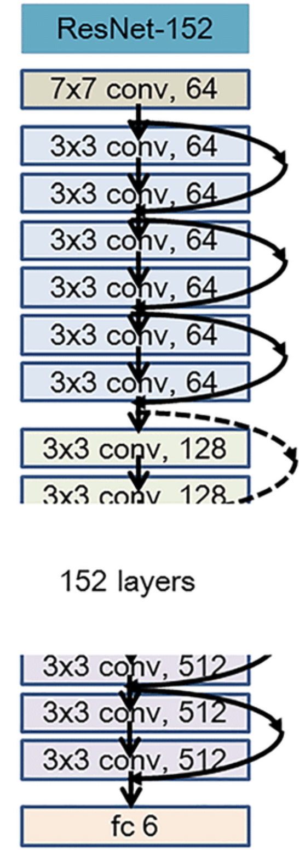
🔮 BiT-M model
Google Model (stronk)
ResNet v2 - 152 layers (x4)
Trained on ImageNet
14.2 M images
21k classes

Slide 15
🔮 BiT-M model
ResNet v2
Group Normalization + Weight Std
SGD
Learning rate decay

Slide 16
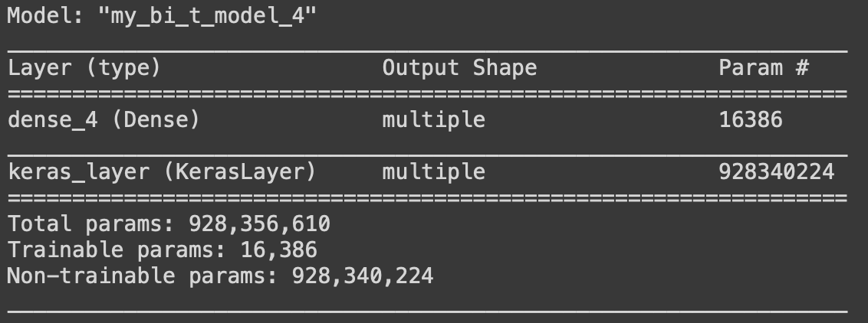
🔮 BiT-M model

Slide 17
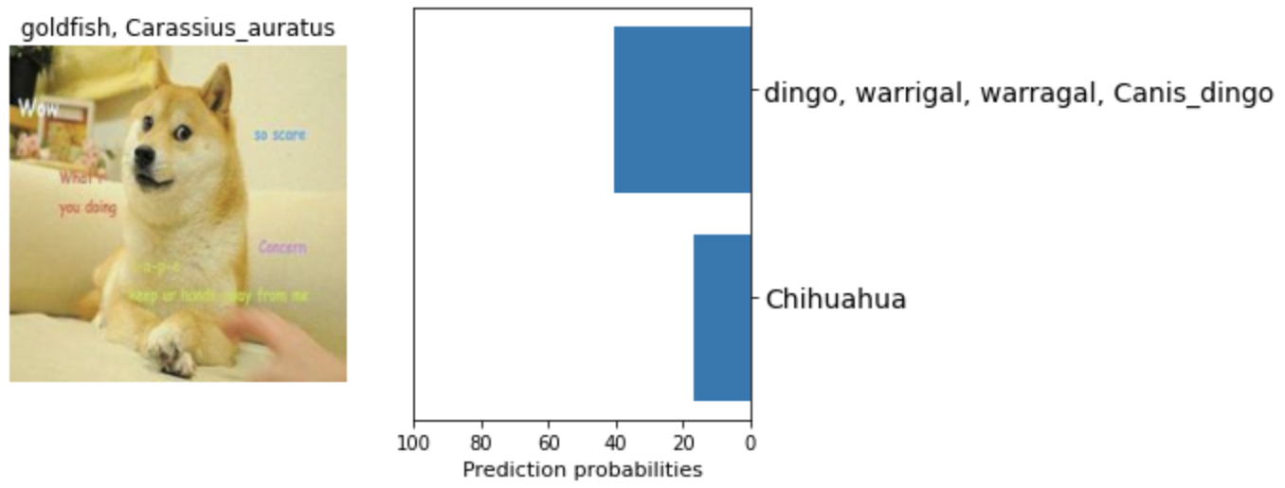
🔮 BiT-M model

Slide 18
🔮 BiT-M model
Augmentations (random flips / crops / resize)
HyperParam rules (not very useful since we only trained 10 epochs)
SGD on the last dense layer
CrossEntropy loss

Slide 19
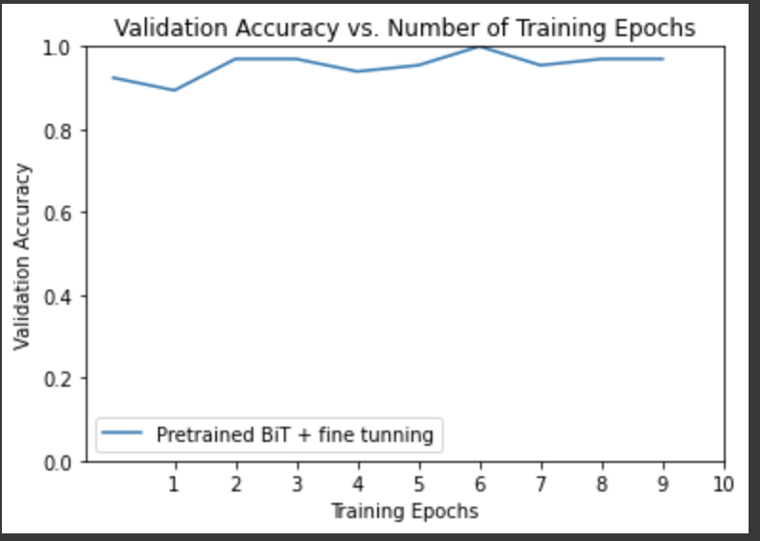
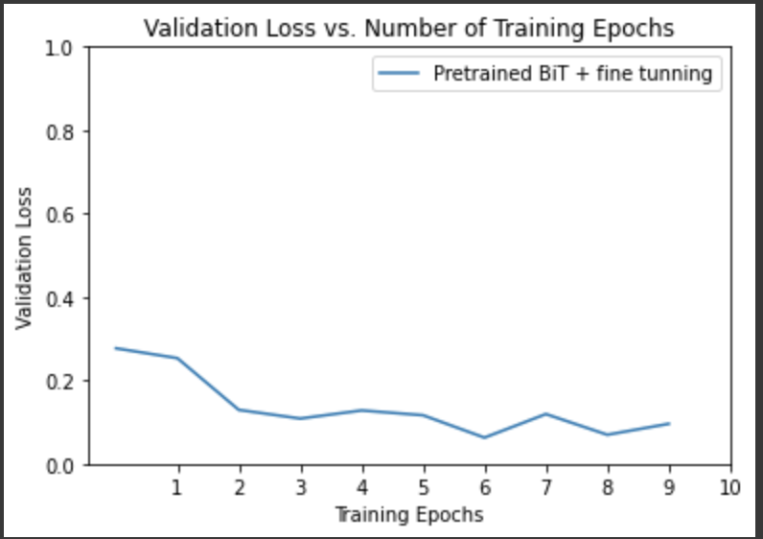
🔮 BiT-M model

Slide 20
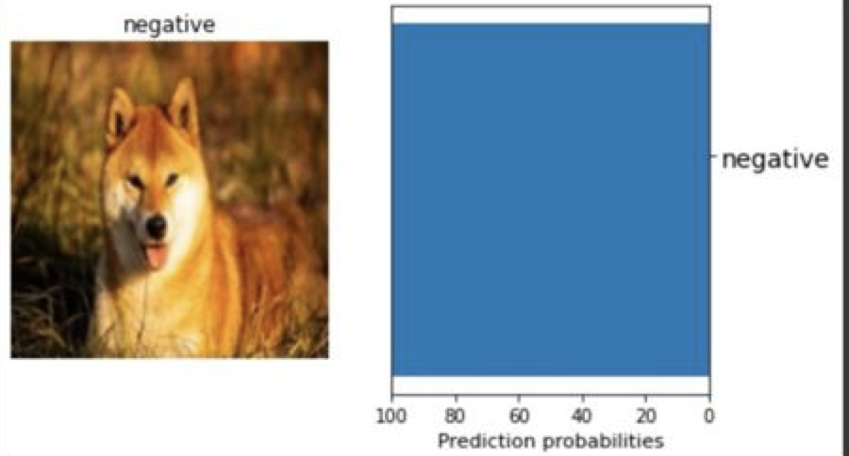
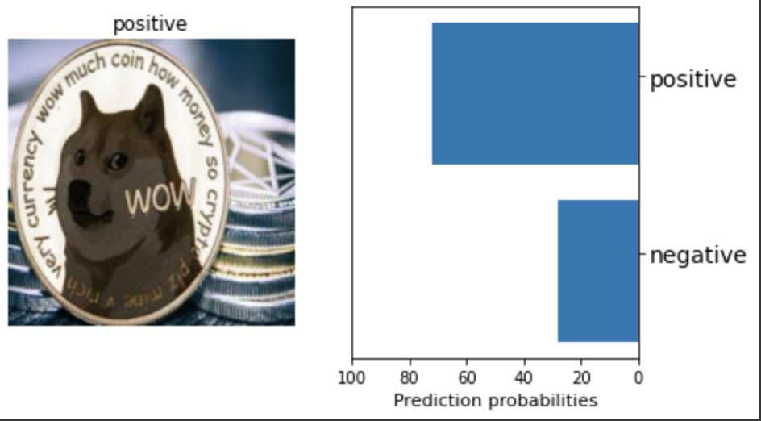
🔮 BiT-M model

Slide 21
🔮 1-Class Classification
Applied for cases with huge class imbalance (e.g. spam/not-spam email)
Train with ONLY positive data

Slide 22

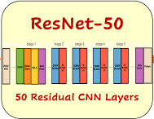
🔮 1-Class Classification
Training process:
StandardScaler
+
PCA
1-class SVM
Extracted features
Reduced features
Fitted SVM model, scaler, and PCA
Input
Output
(ONLY doge images)
(without classifier)

Slide 23
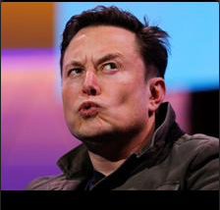
🔮 1-Class Classification
Inference process:
Fitted StandardScaler
+
PCA
Fitted 1-class SVM
Extracted features
Reduced features
⛔️
Not doge
Input
Output
(Any images)
(without classifier)

Slide 24
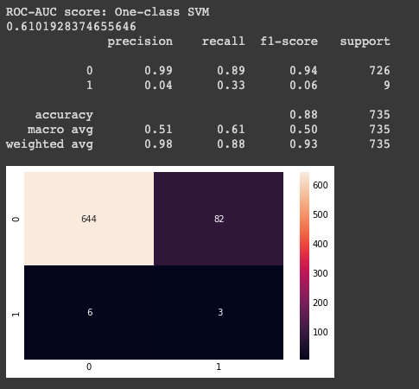
🔮 1-Class Classification
Possible causes:
Not properly tuned params
One-class SVM is not ideal
Direction for improvement:
Better tune hyperparameters
Try different classifiers (e.g. Gaussian Mixture and Isotonic Regression)
Learning points:
Finalize the dataset before training
Select suitable metric for the problem

Slide 25




🕹️ Demo

Slide 26
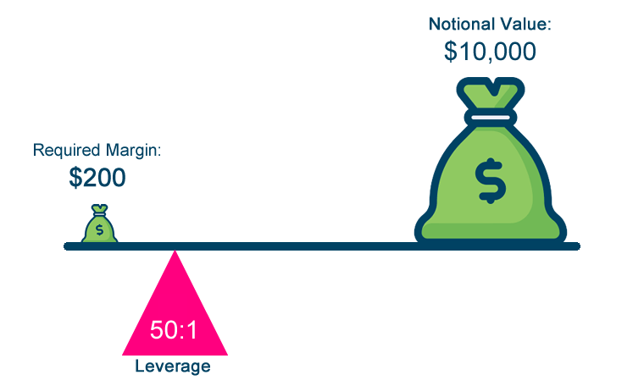
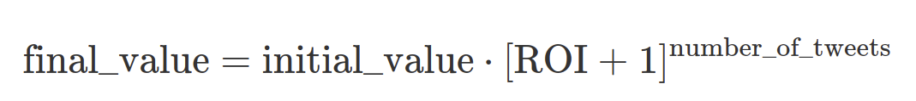
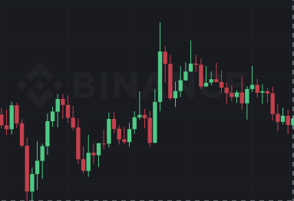
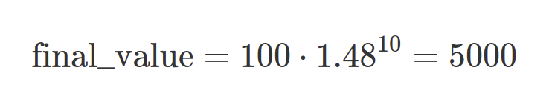
🕹️ Demo
Future???
Elon tweeted about 10 images since 10 Dec (and many more textual tweets)
RoI average per tweet is 2.4%
Leverage x 20 = 48% (Futures!)
Put 100 dollars
Assume bot always online, never crashes
Assume bot recognizes all doge related meme’s
Assume price always goes up after a tweet
Compounding profit

Slide 27
🕹️ Demo

Slide 28

✅ Conclusions
Tested several approaches
AlexNet - 86.7% accuracy
ResNet - 86.09% accuracy
SqueezeNet - 86.06% accuracy
VGG - 85.9% accuracy
DenseNet - 86.3% accuracy
BiT-M - 98% accuracy
1CLF - 88% accuracy
Training takes a LOT of time and is heavy on RAM usage
1-CLF is a good approach, but needs a lot of fine-tuning
Effectively implemented a deep learning model in an existing infrastructure
Learned the necessary skills to apply to any social media / stock connection $$$

Slide 29

Recommendations
Switch to segmentation: focalloss / diceloss
Apply activations based on distances between images
Hard Negative example mining
Find more connections between social profiles and crypto / stocks and apply the same method
Notes:
download huge dataset of images ~ 200 dogecoin, large dataset unrelated doge. CrossEntropy loss => accuracy. Easy for model to trick me and get almost perfect accuracy that something is not a dogecoin. ImageNet / Random Images (BIG > 20000). After that you need to somehow train the model and you need a new loss function (focalLoss / diceloss / Lovász-Softmax loss:). The Lovász-Softmax loss: A tractable surrogate for the optimization of the intersection-over-union measure in neural networks.
Mining of hard examples. How?
way 1: Similar images mining. just check images for similarity, for instance define distance between images and check how close they are. So building a dataset where the images are really really similar. Easy for model to make a mistake if there are very relatable images, therefore if you train a model on a hard example dataset, new inputs will be easily differed from a dogecoin related image. The best way to define similarity is a neural network itself. Dont train special network which compares images. Just train a network which is already trained (ImageNet + ResNet). When you apply it to the image you have some activation in the end, and a good distance between images would be distance between these activations. Thuss iff activations are similiar images should be similar.
way 2: Hard Negative example mining. (continuation of way 1). During training you get pos and neg in equal proportion. Increase the weight when you make a mistake, if not make mistake reduce weight. Therefore automatically take the samples which are hardest for your model.
way 3: One-class classification methods. Recommend a similar concept to binary classification. But compared to bin-classf your goal is usually to find something like find some soft edge which defines one edge from another. Below is the classification problem.

Slide 30
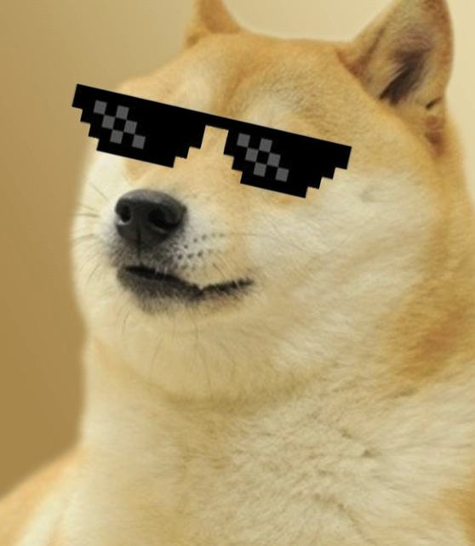
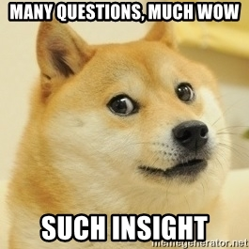
Thank you! Questions?

